Slide 1

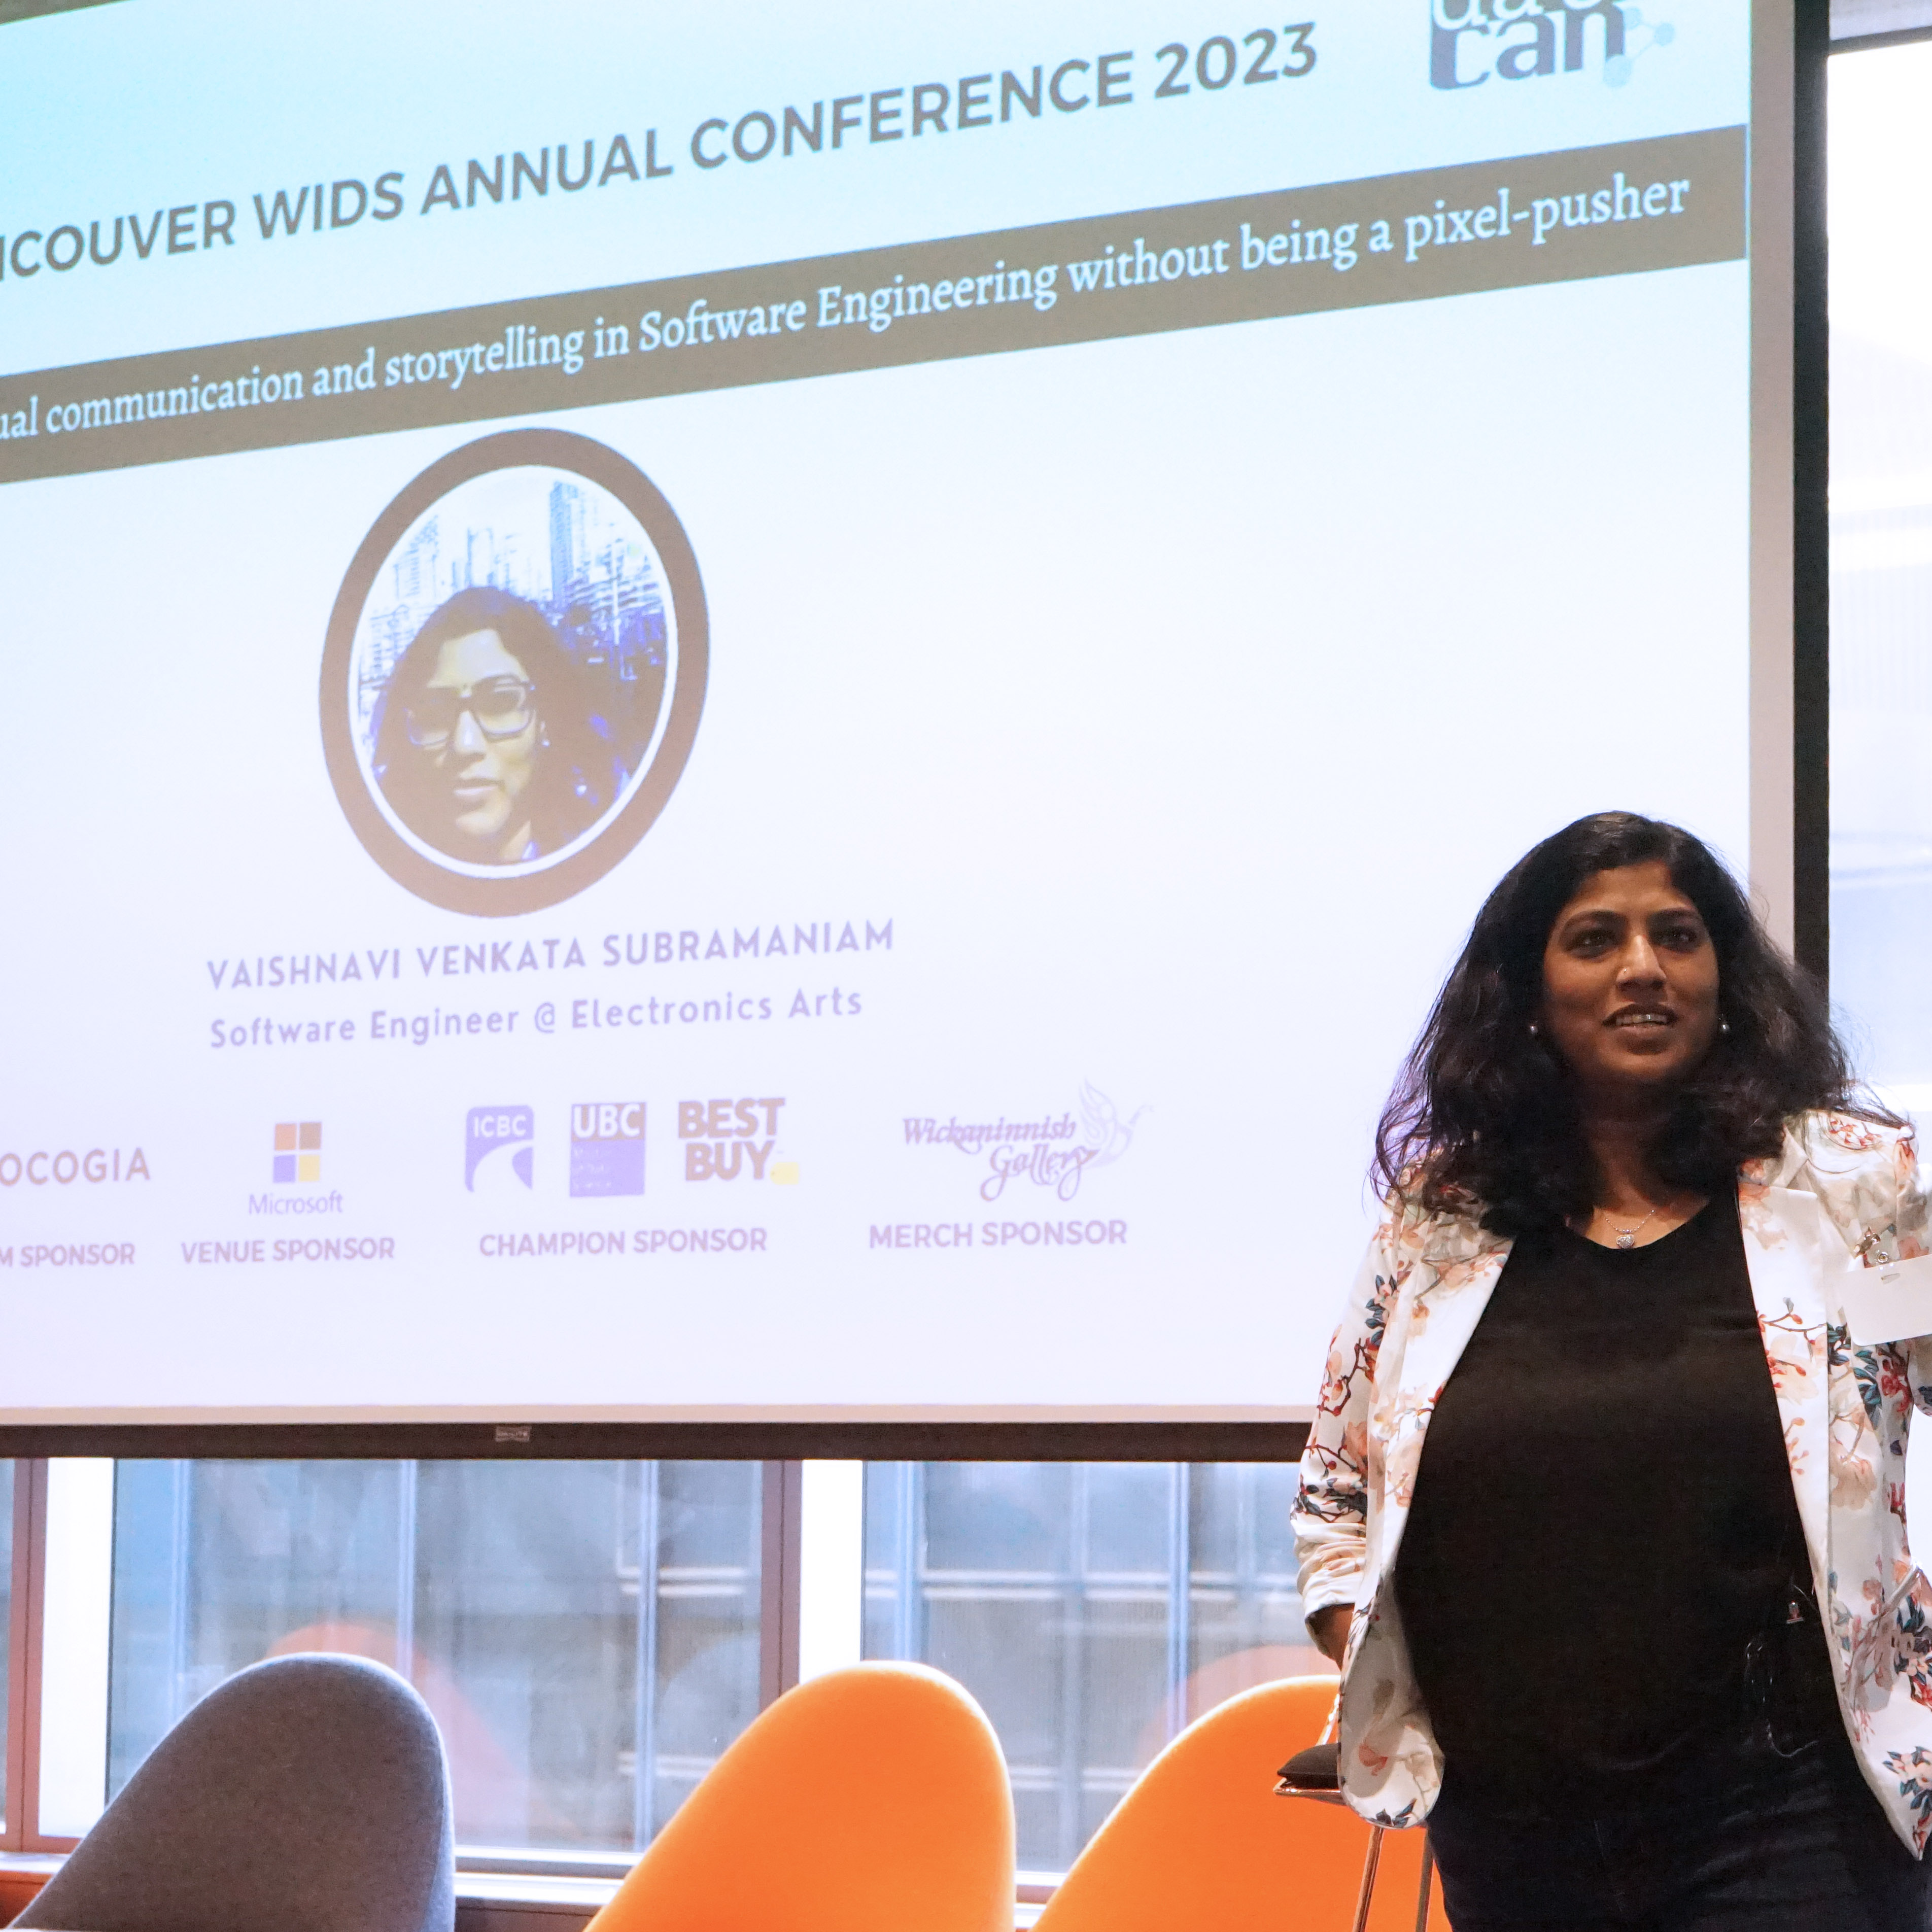

Integrating visual communication and storytelling in Software Engineering
Vaishnavi V
Solutions Architect | Code Wrangler

Slide 2
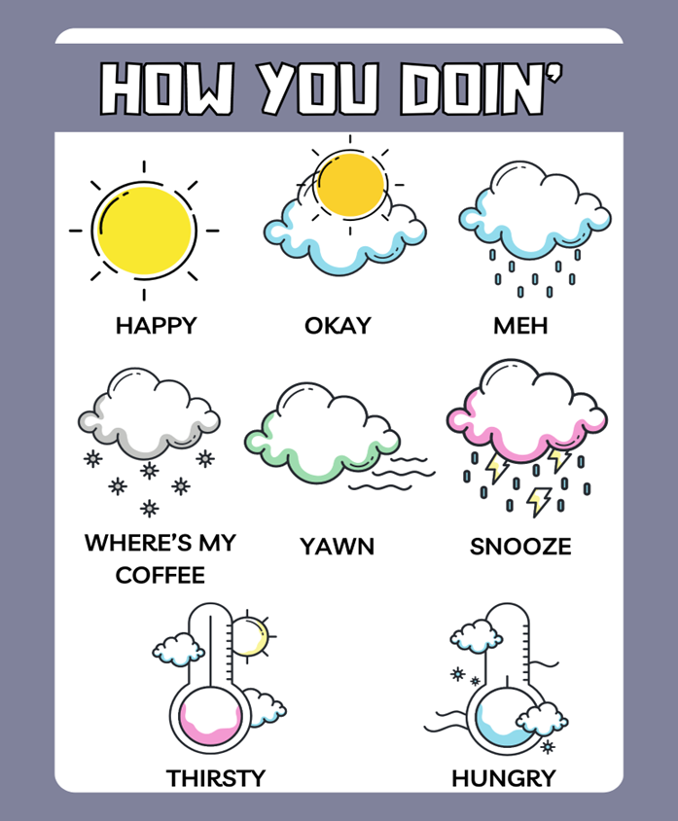
Notes:
Joey Tribbiani from the sitcom Friends

Slide 3
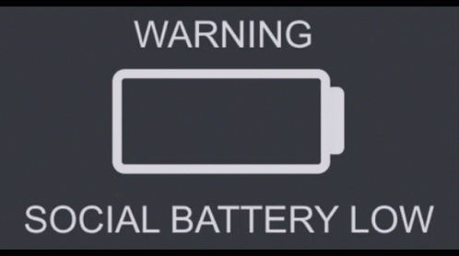
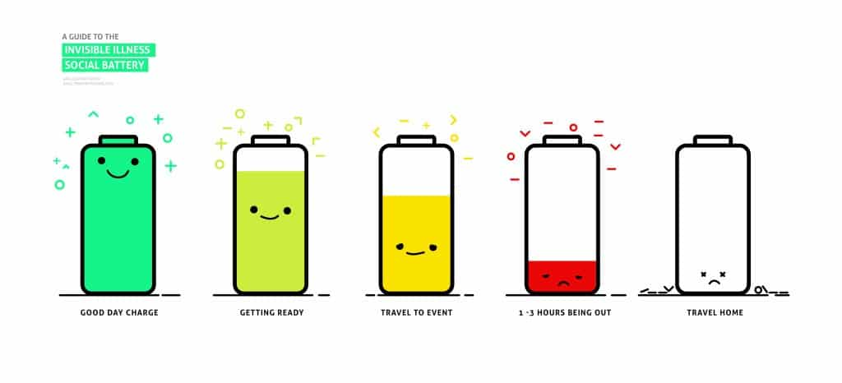

Slide 4


Slide 5


Disclaimer

Slide 6
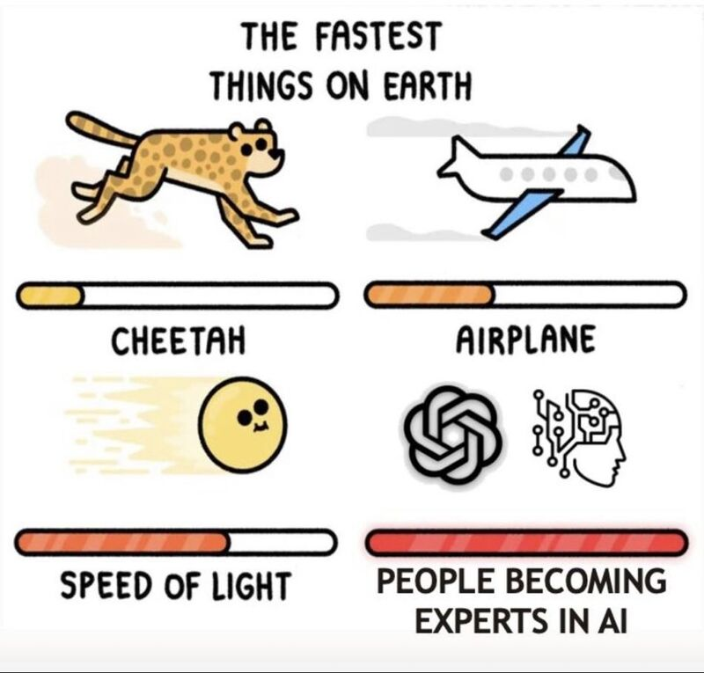
Not an expert!
Notes:
We're now witnessing the Dunning-Kruger effect in action and scale never seen before 😅
Remember - AI won't take your job but people who are "experts" in AI will 😉

Slide 7
Glossophobia

Slide 8


Slide 9
Presentation is auto biographical – Sample size of 1 No spandex required!

Slide 10
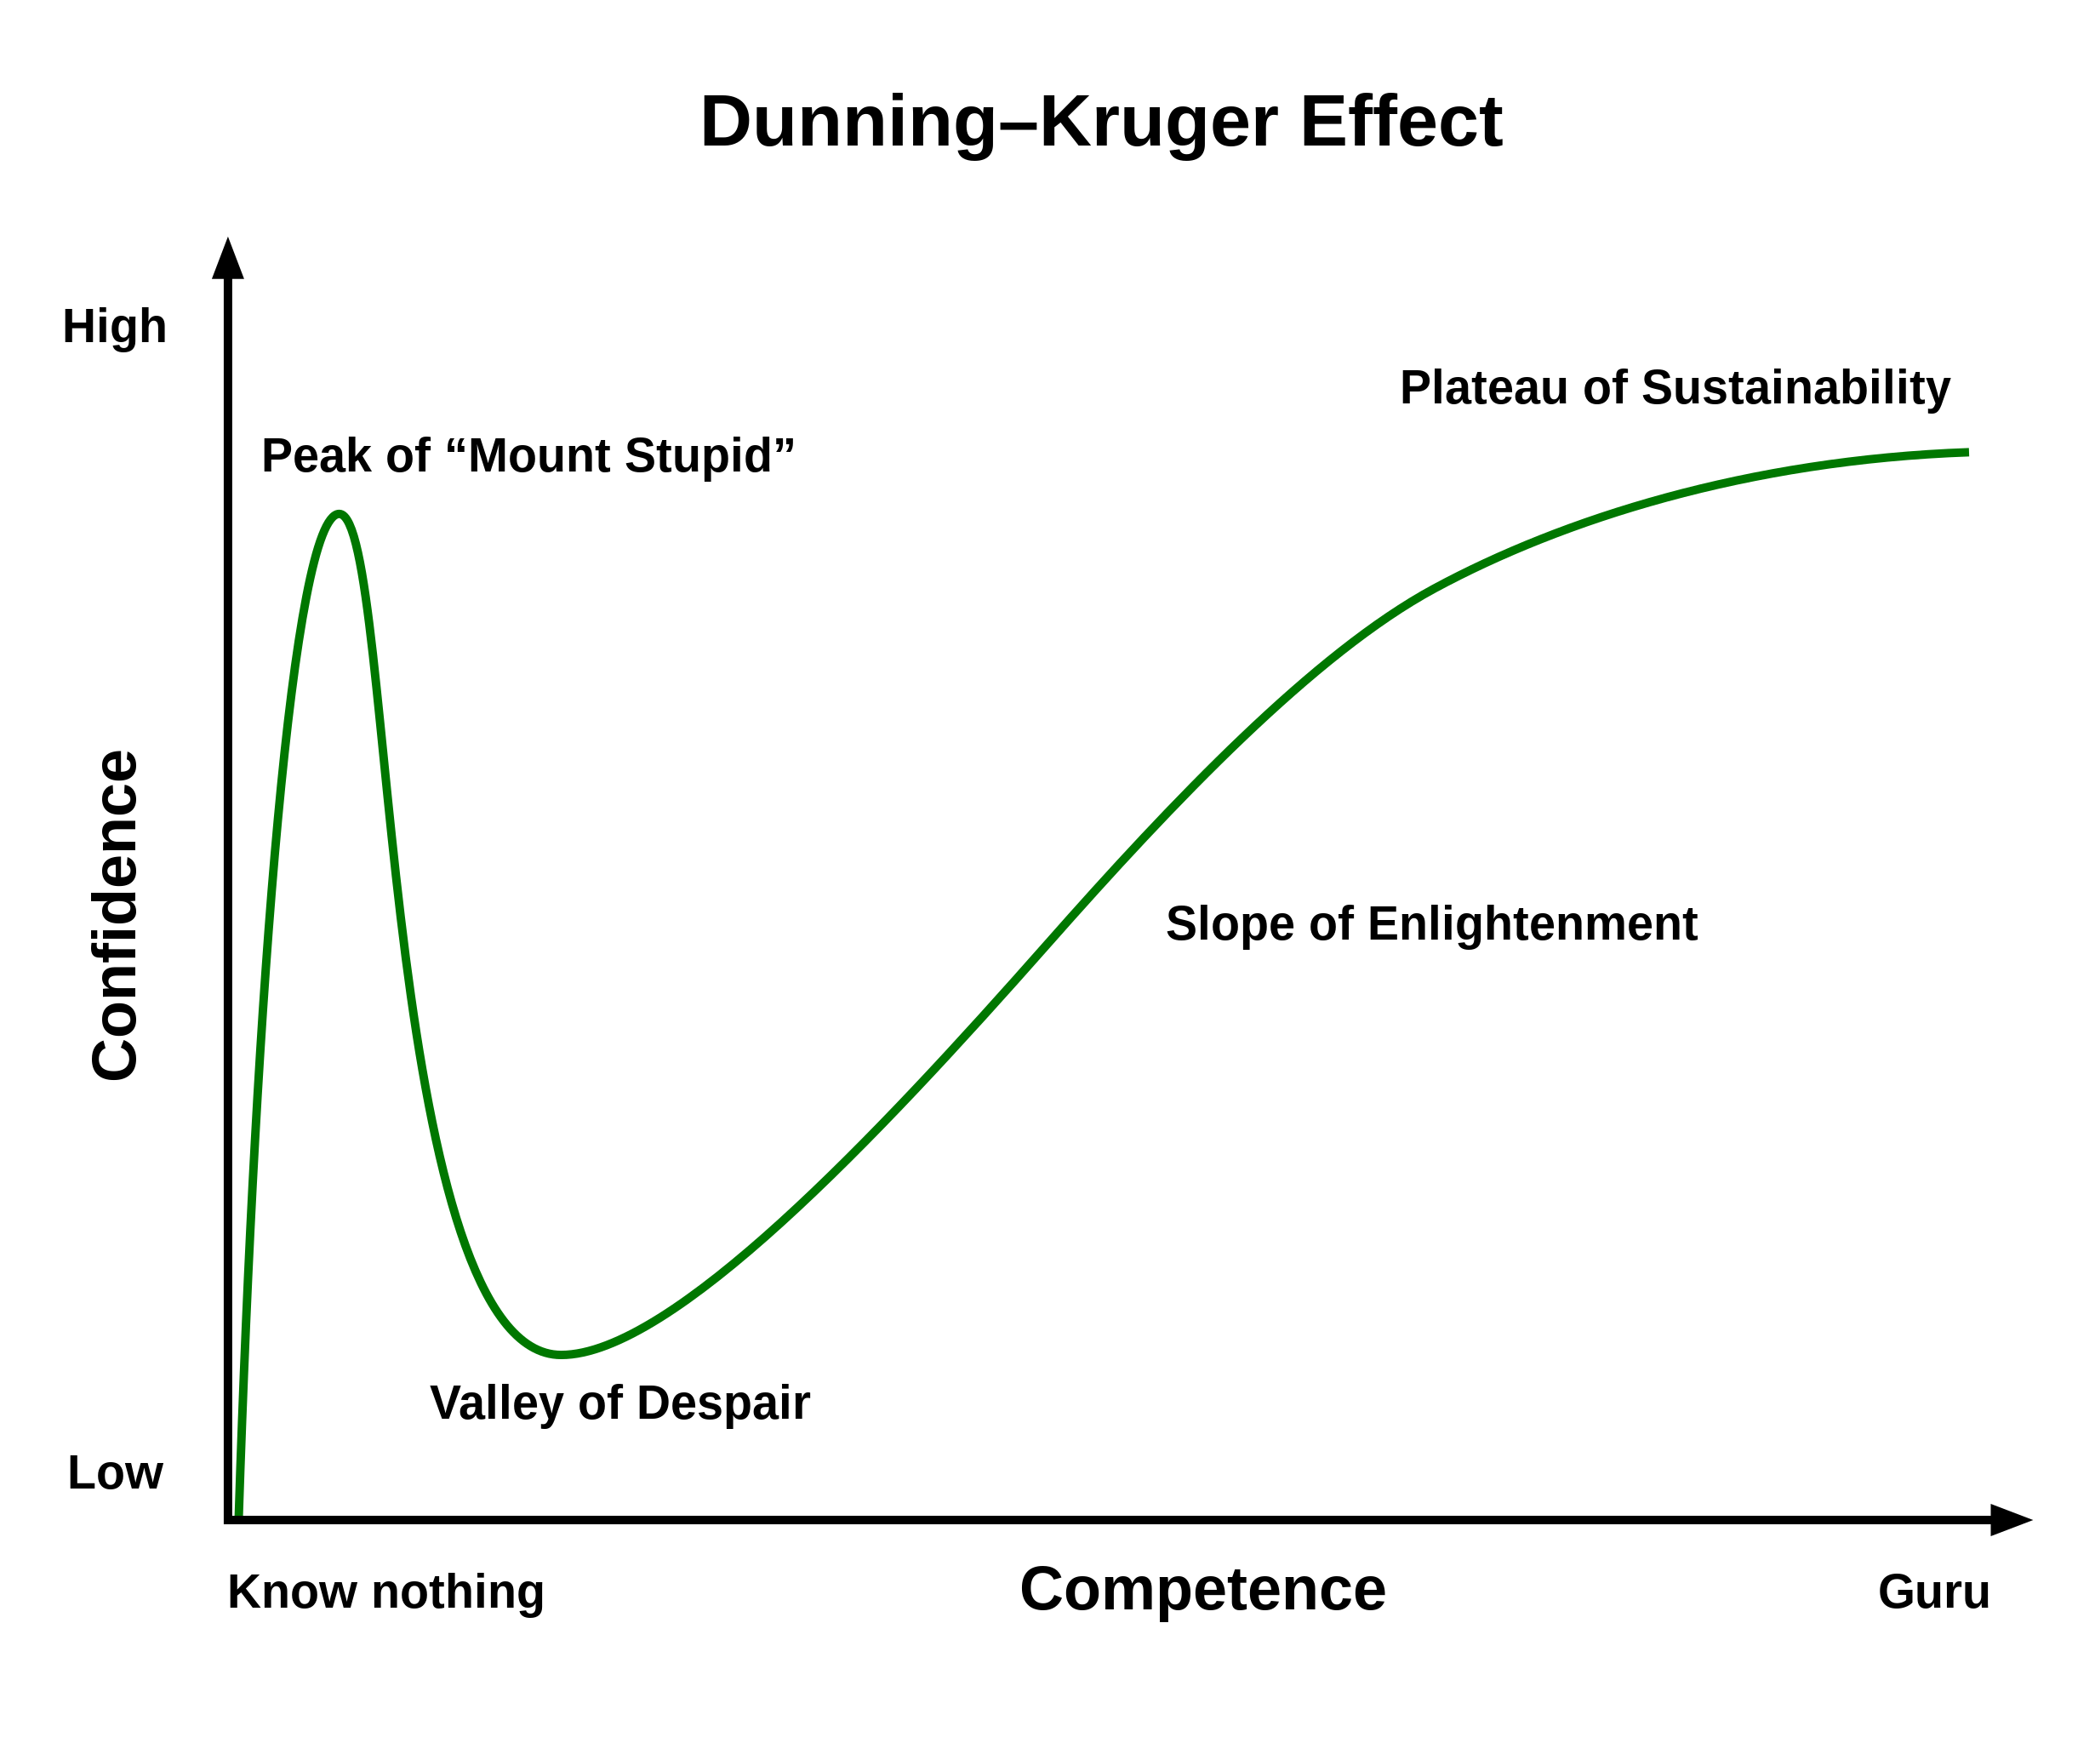

Slide 11
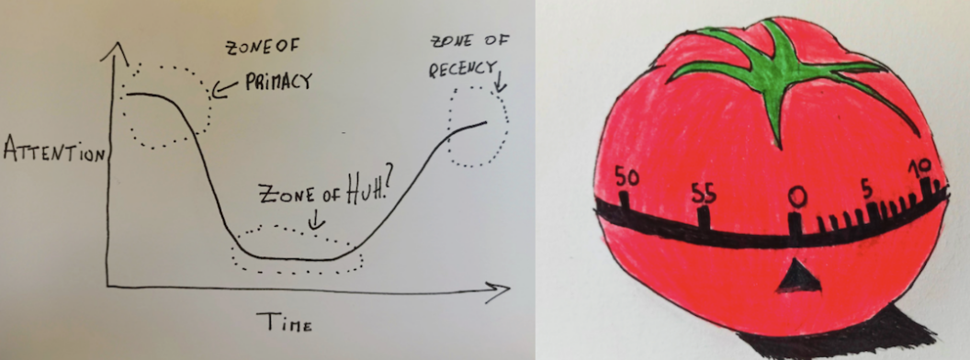
Attention Span
Source : https://semaphoreci.com/blog/storytelling-programming
Notes:
When we perform a task, like learning for an exam, our level of attention varies:
Zone of Primacy: our attention level is high (first 20 minutes)
Zone of Huh: our attention level is low (unlimited)
Zone of Recency: our attention level is high again (last 5 minutes)

Slide 12
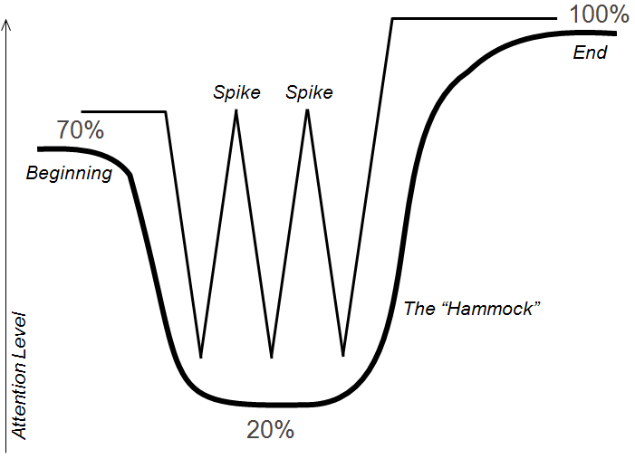
Human attention : The Hammock and the Spikes
Source : Keeping the Audience Engaged with Presentation “Spikes”
Notes:
When we perform a task, like learning for an exam, our level of attention varies:
Zone of Primacy: our attention level is high (first 20 minutes)
Zone of Huh: our attention level is low (unlimited)
Zone of Recency: our attention level is high again (last 5 minutes)

Slide 13
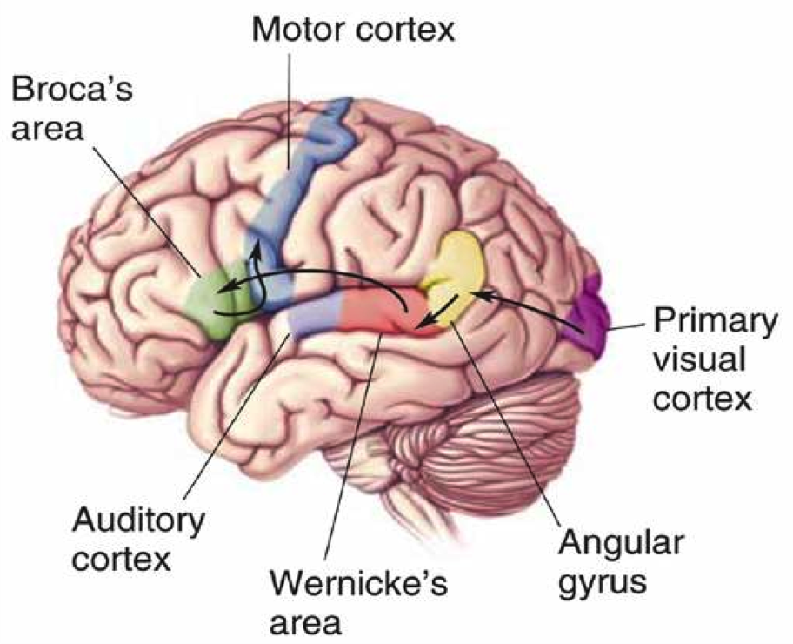
Visual information vs reading words
Notes:
The part of the brain that processes visual information (the visual cortex) is much larger than the part of the brain responsible for reading words (the broca). By providing your information in a visual presentation, you make it much easier on your team to process the information effectively.

Slide 14
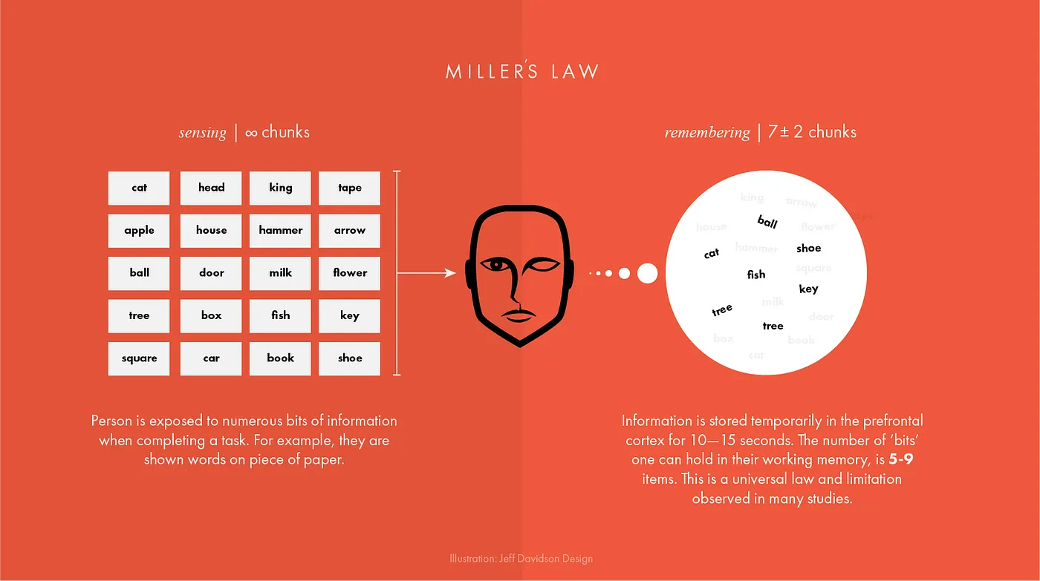
Unique
Tested
Telling stories through visuals and data
Elephant
Authentic
Harnessing color to illustrate importance and attract attention
Creating more memorable information through the use of symbols and icons
Notes:
The first concept is "chunking" and the capacity of short term memory. Miller (1956) presented the idea that short-term memory could only hold 5-9 chunks of information (seven plus or minus two) where a chunk is any meaningful unit. A chunk could refer to digits, words, chess positions, or people's faces. The concept of chunking and the limited capacity of short term memory became a basic element of all subsequent theories of memory.

Slide 15
George Miller’s Magical Number of Immediate Memory
Unique
Tested
Showing the impact of your work by using data visualization
Telling stories through visuals and data
Elephant
Authentic
Creating more memorable information through the use of symbols and icons
Harnessing color to illustrate importance and attract attention
Notes:
Humans are visually oriented animals with approximately 55% of our cortex is dedicated to processing visual stimuli.
The first concept is "chunking" and the capacity of short term memory. Miller (1956) presented the idea that short-term memory could only hold 5-9 chunks of information (seven plus or minus two) where a chunk is any meaningful unit. A chunk could refer to digits, words, chess positions, or people's faces. The concept of chunking and the limited capacity of short term memory became a basic element of all subsequent theories of memory.

Slide 16

Definition
Visual communication is the practice of using visual elements to get a message across, inspire change, or evoke an emotion.

Slide 17
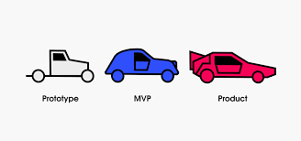
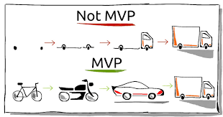
Perfect MVP
Communication design refers to crafting a message that educates, motivates, and engages the viewer.
Graphic design uses design principles to communicate that message in a way that is clear and eye-catching to the intended audience.

Slide 18
Z73. 0
Notes:
The repository on GitHub states that the name "996. icu" refers to how developers who work under the 996 system (9AM–9PM, 6 days per week) would risk poor health and a possible stay in an intensive care unit. The movement's slogan is "developers' lives matter".

Slide 19
996. icu
Notes:
The repository on GitHub states that the name "996. icu" refers to how developers who work under the 996 system (9AM–9PM, 6 days per week) would risk poor health and a possible stay in an intensive care unit. The movement's slogan is "developers' lives matter".

Slide 20
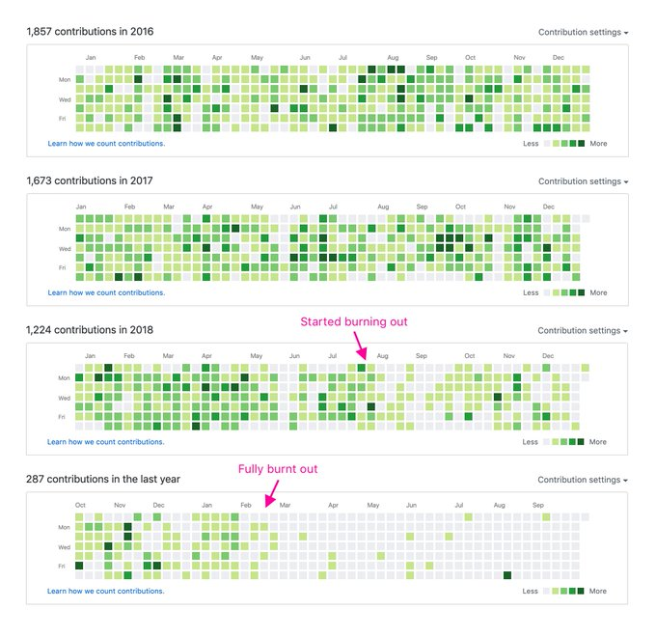
Visualizing burnout
Credits : Jonnie Hallman

Slide 21
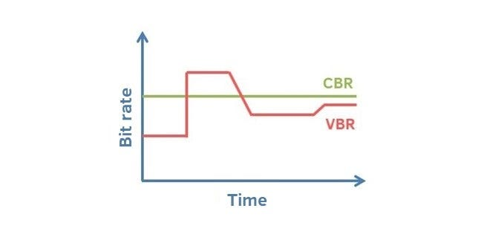
Crest and trough

Slide 22
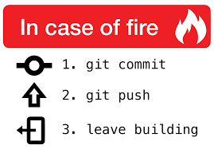
Tell, Don’t Ask
“Programs must be written for people to read, and only incidentally for machines to execute” (SICP)*
Structure and Interpretation of Computer Programs

Slide 23
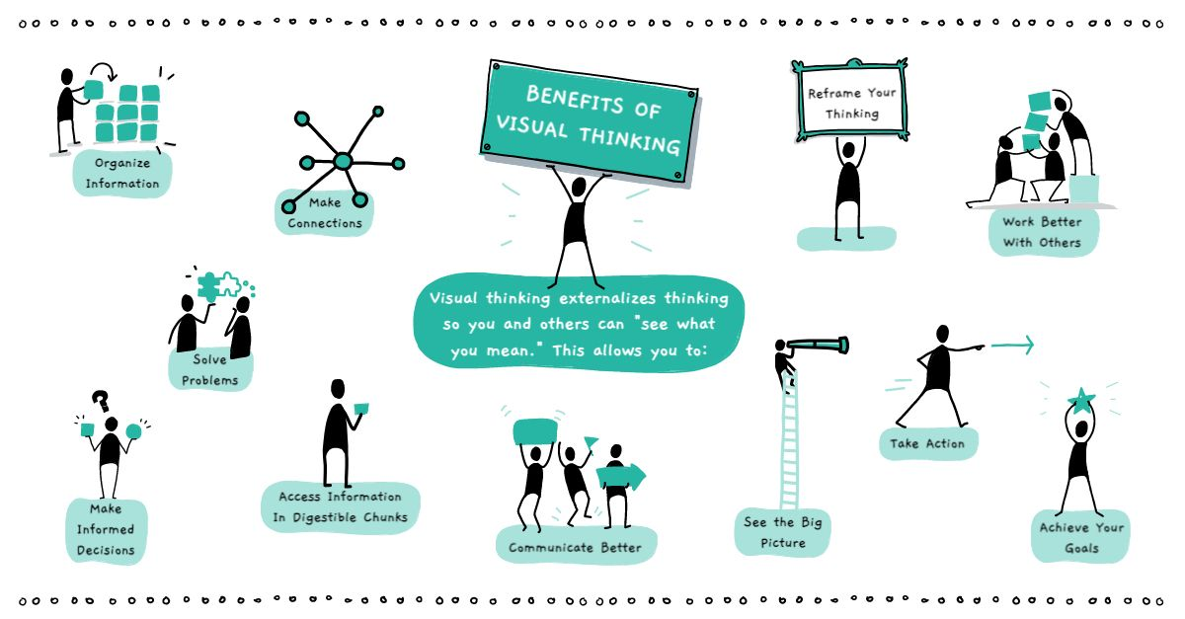
Definition
Visual communication is the practice of using visual elements to get a message across, inspire change, or evoke an emotion.
Source : Drawify

Slide 24

Examples

Slide 25
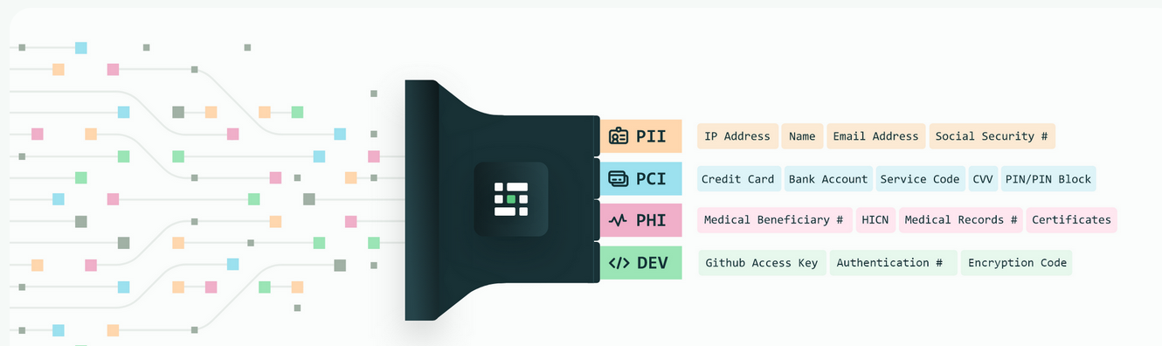
Privacy
Source : Medium blog
Notes:
Personal Identifiable Information (PII) is defined as: Any representation of information that permits the identity of an individual to whom the information applies to be reasonably inferred by either direct or indirect means.

Slide 26
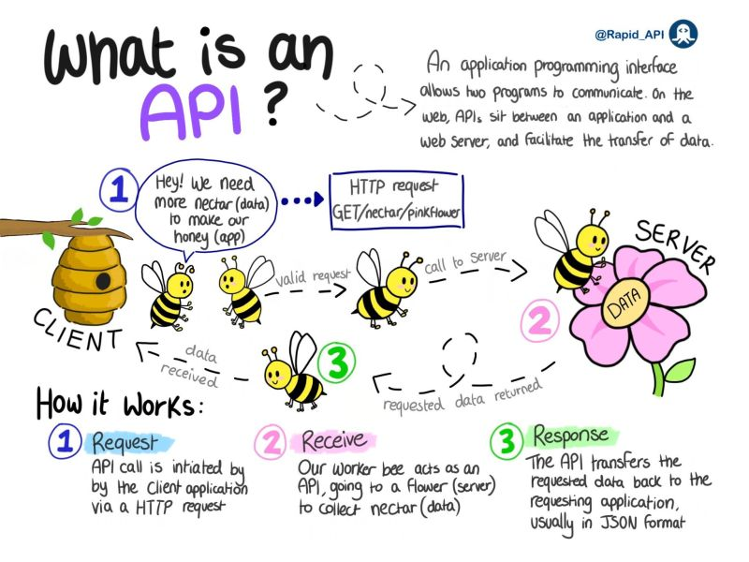
Source :
Notes:
Personal Identifiable Information (PII) is defined as: Any representation of information that permits the identity of an individual to whom the information applies to be reasonably inferred by either direct or indirect means.

Slide 27
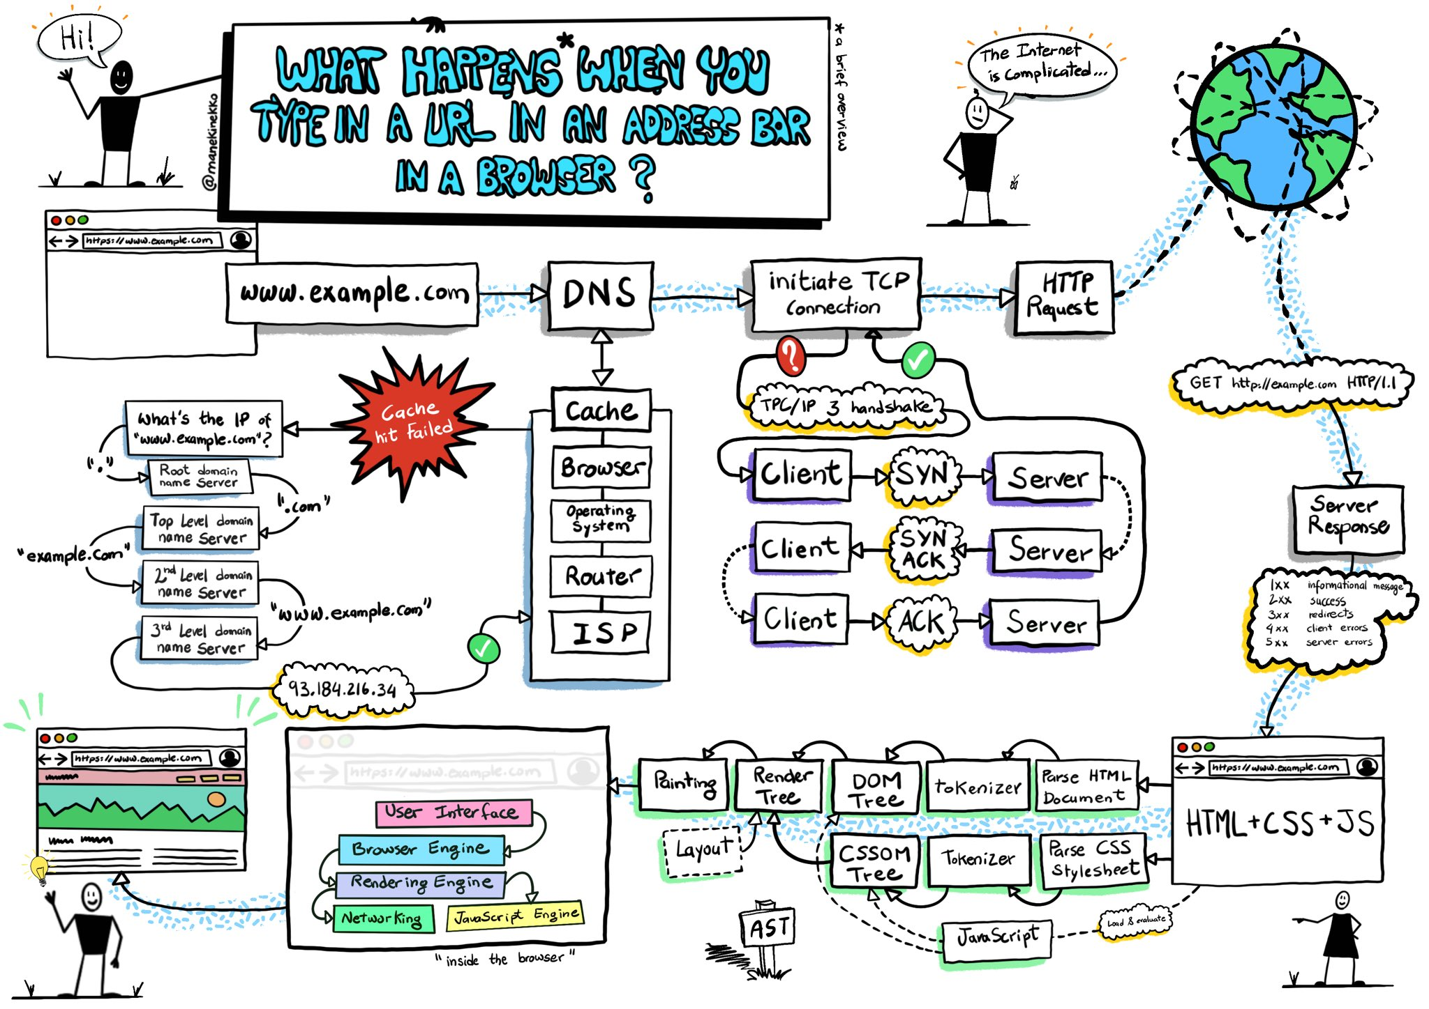
ELI5
Source :Wassim Chegham
Notes:
Personal Identifiable Information (PII) is defined as: Any representation of information that permits the identity of an individual to whom the information applies to be reasonably inferred by either direct or indirect means.

Slide 28
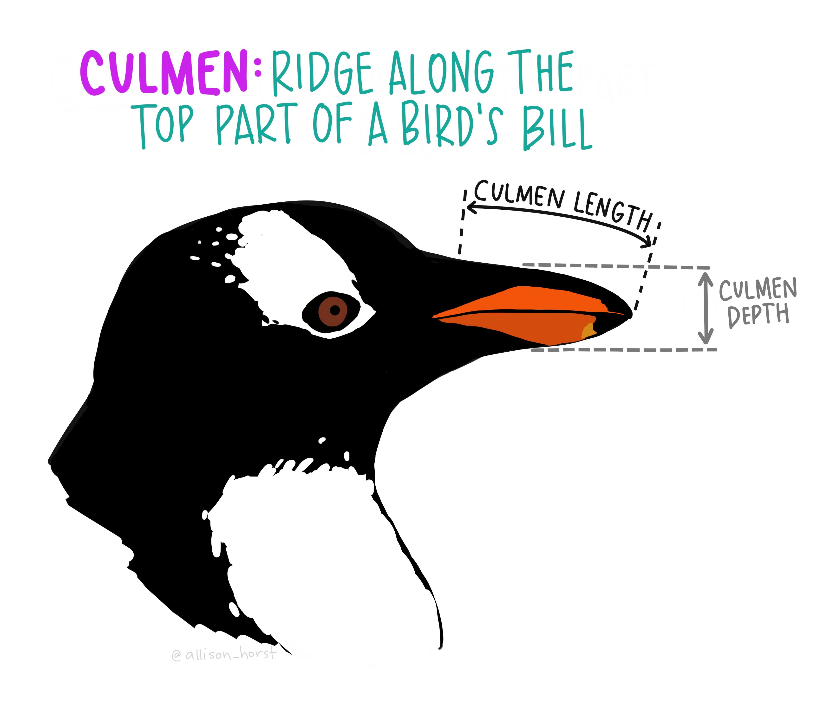
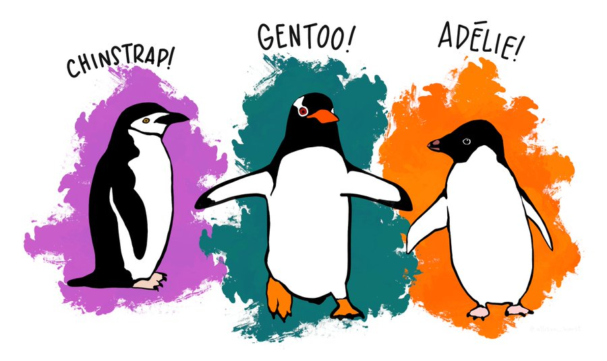
Penguin Dataset
Goal
Determine the species of a penguin
Parameters :
• Culmen length
• Culmen depth
• Flipper length
• Body mass
Source : Twitter

Slide 29
Manual Of Me

Slide 30


Slide 31
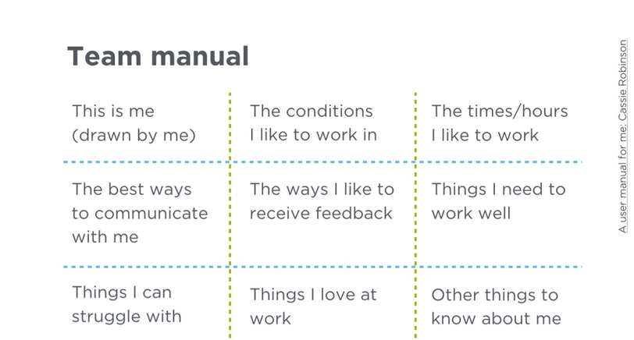

Slide 32
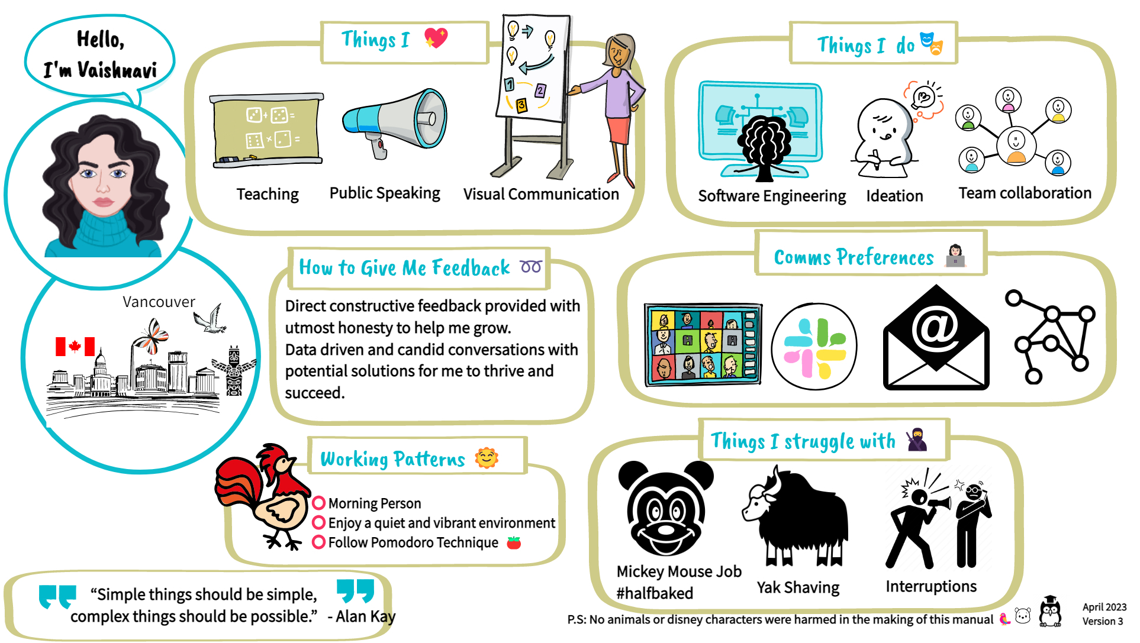

Slide 33
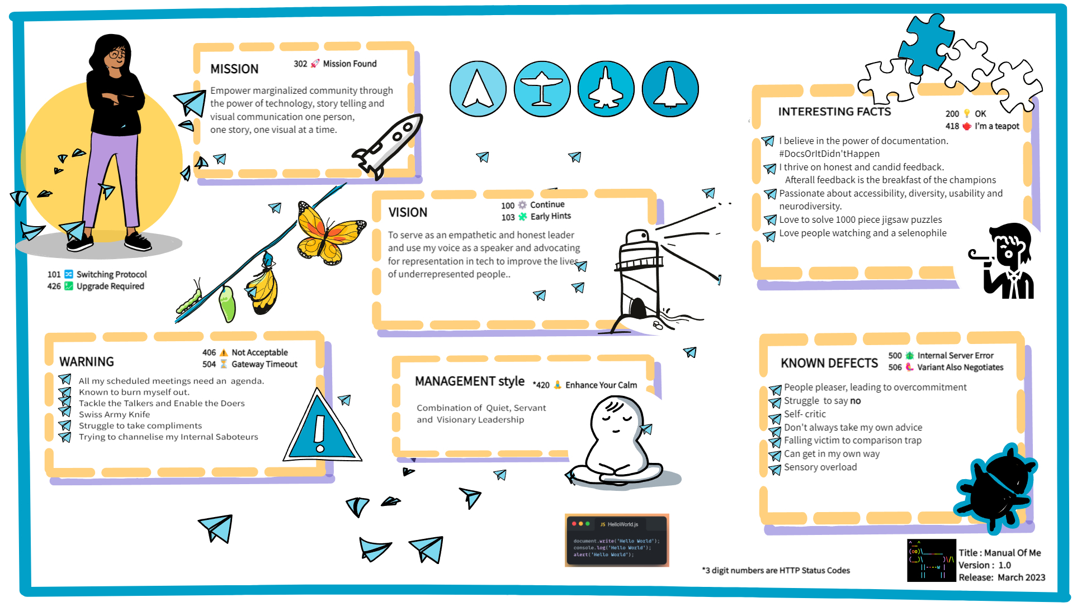
Meet the team

Slide 34
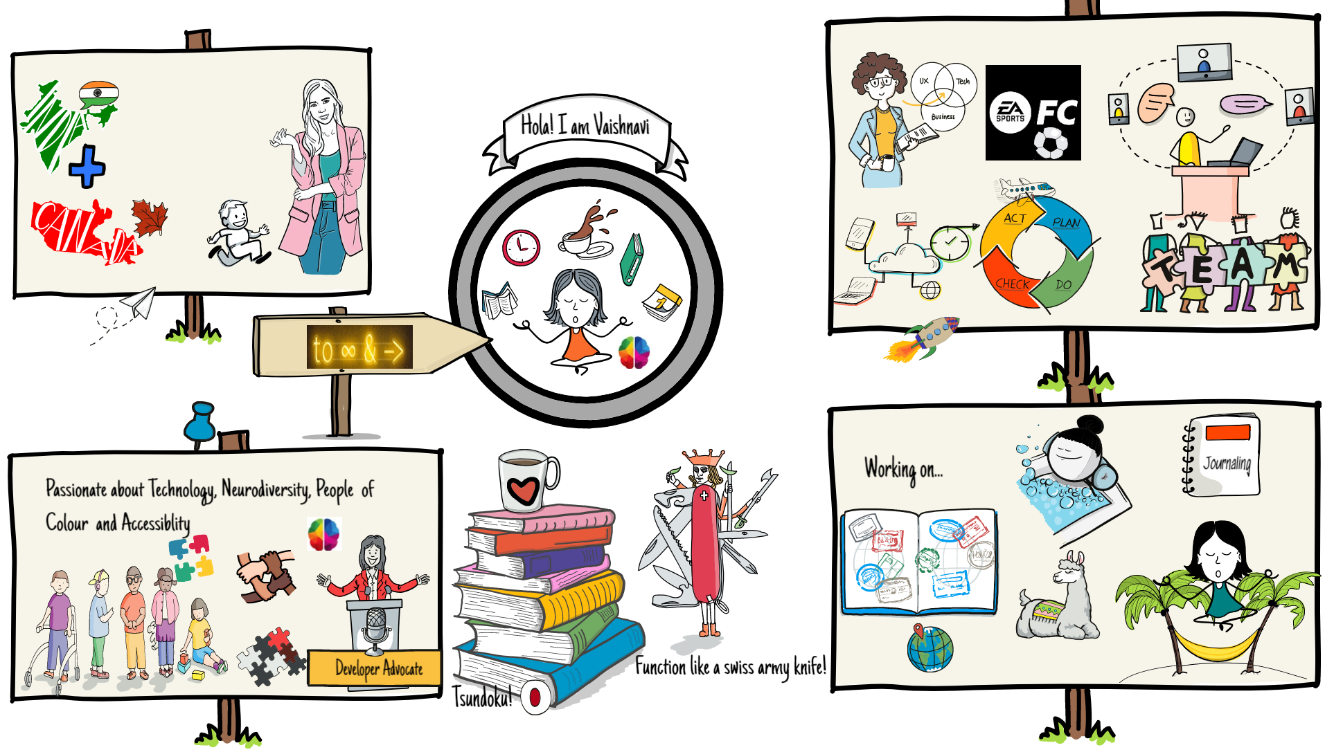
Meet the team

Slide 35
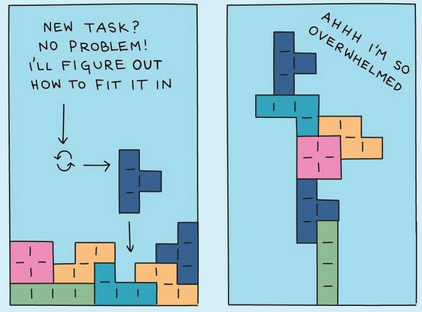
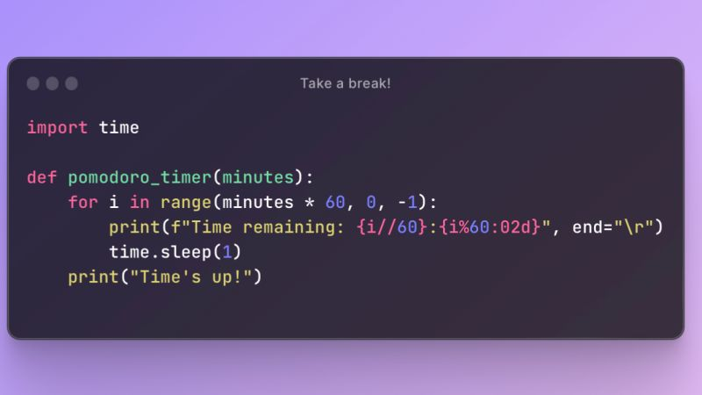

Ideas
$3B
$2B
$ 1B
Opportunity to build
Fully inclusive market
Total addressable market
Freedom to invent
Selectively inclusive market
Serviceable available market
Few competitors
Specifically targeted market
Serviceable obtainable market

Slide 36
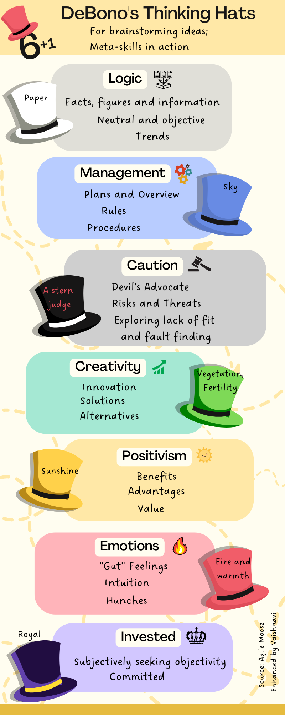

Slide 37
Resources
Plant UML
Waysfinder Framework
The Waysfinder provides a scaffold that enables new thinking and practice, not a series of linear steps. It is made up of a combination of various types of constraints and wayfinding practices that collectively create a coherent adaptive space or search field.

Slide 38
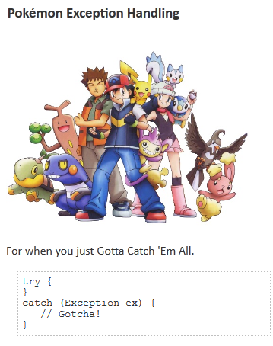
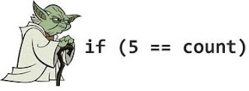
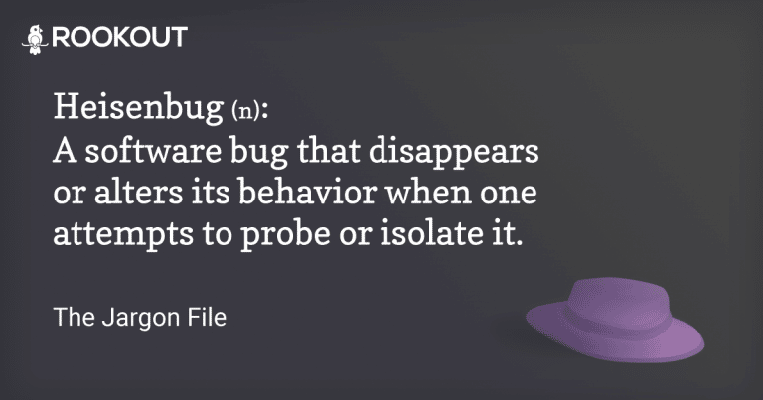

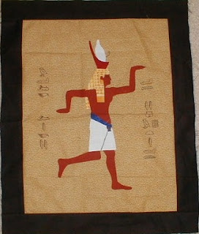
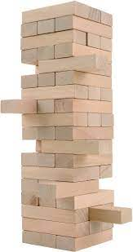
Programmer Jargon

Slide 39
Precaution

Slide 40

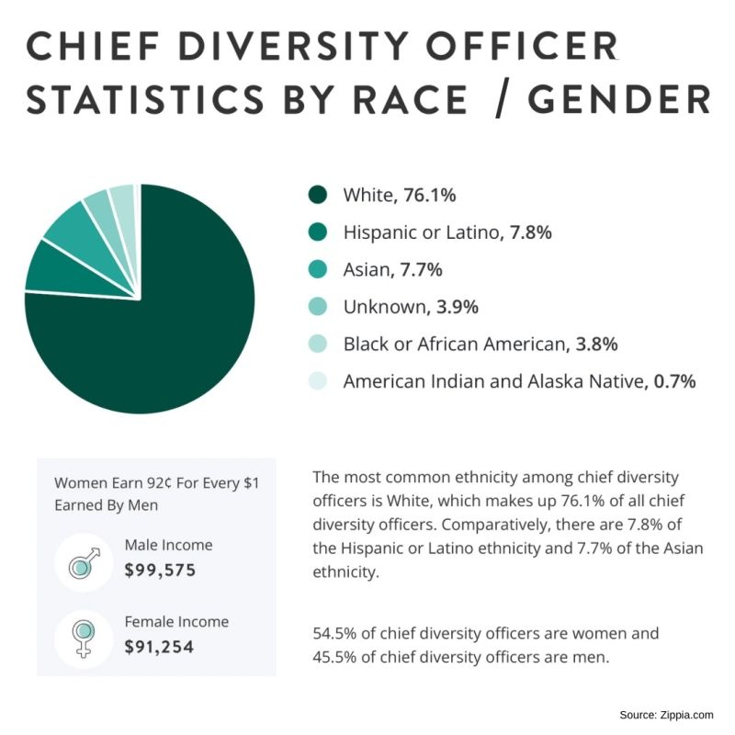
Overwhelming the user!

Slide 41

Clutter
Copyright: .marqs / photocase.com

Slide 42

Colors alone
Inaccessible
Red-green color blind?
Course # | Name
Algo 101 | Introduction to Algorithms
Networking 101 | Topology and Networking
Gardening 101 | Soil therapy for beginners

Slide 43
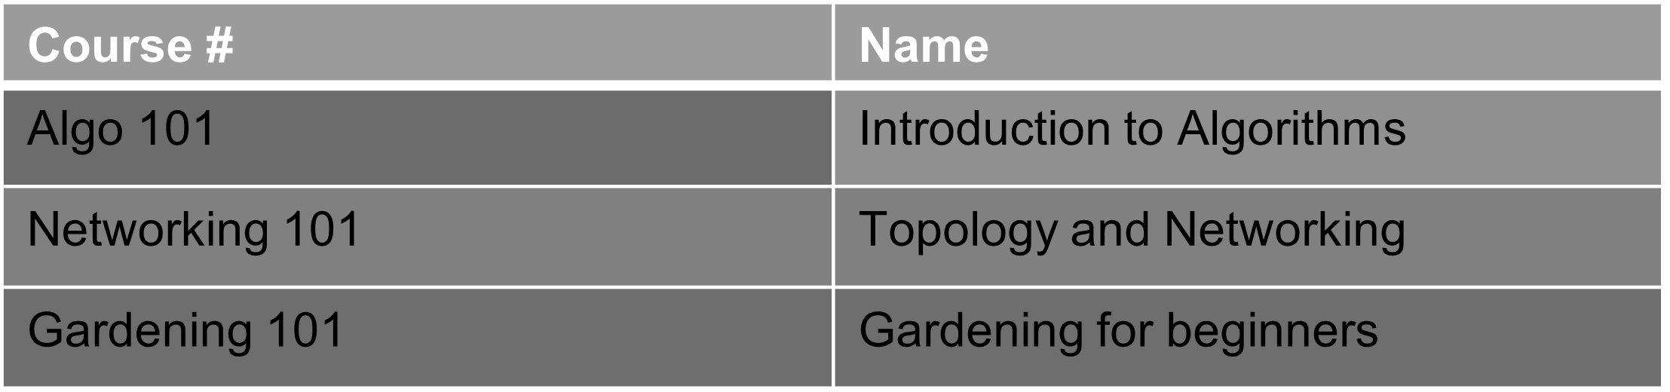
Colors alone!

Slide 44

Alternate means of communication
Accessible Example
Course # | Name | Required
Algo 101 | Introduction to Algorithms | Yes
Networking 101 | Topology and Networking | No
Gardening 101 | Gardening for beginners | No

Slide 45


Misinterpretation or reading between the lines?

Slide 46
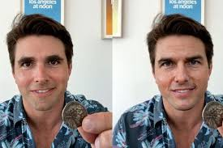
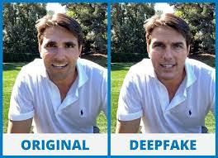
Deepfake technology: seeing is believing, or is it?

Slide 47
“Don’t tell me the moon is shining. Show me the glint of light on broken glass.”
- Anton Checkhov
Notes:
“Don’t tell me the moon is shining. Show me the glint of light on broken glass.” - Anton Checkhov

Slide 48



Slide 49

Memory & Cognition study - 2014
Expectation that one will need to teach can enhance one’s learning and organization of knowledge.

Slide 50
“Best times to start teaching something is shortly after learning it”

Slide 51
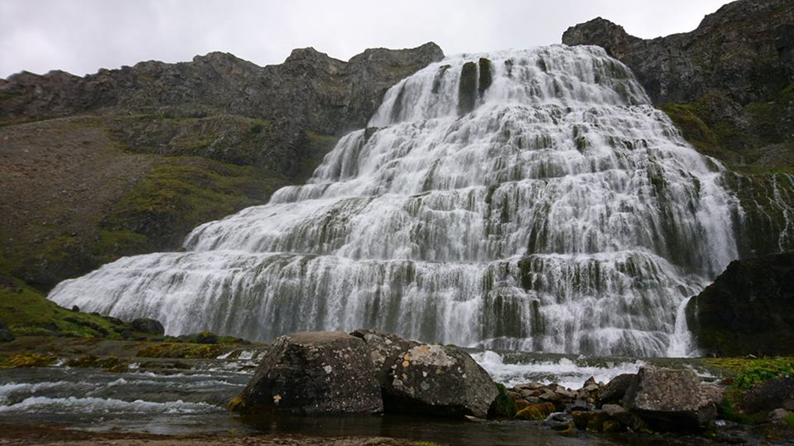

Slide 52
Cascading Mentorship Model
Another form of teaching that utilizes the benefits of the protégé effect, while adding new benefits.
Each student is providing mentorship to someone less experienced than them, and same goes for that person, and so on and so forth

Slide 53
Everyone – even the most junior person – is involved in an active, peer-led exercise that empowers people on every level of experience to understand their own area of practice more deeply.
They are also encouraged to practice their coaching skills, while also analyzing the coaching they receive in order to improve their own skills.

Slide 54


Slide 55
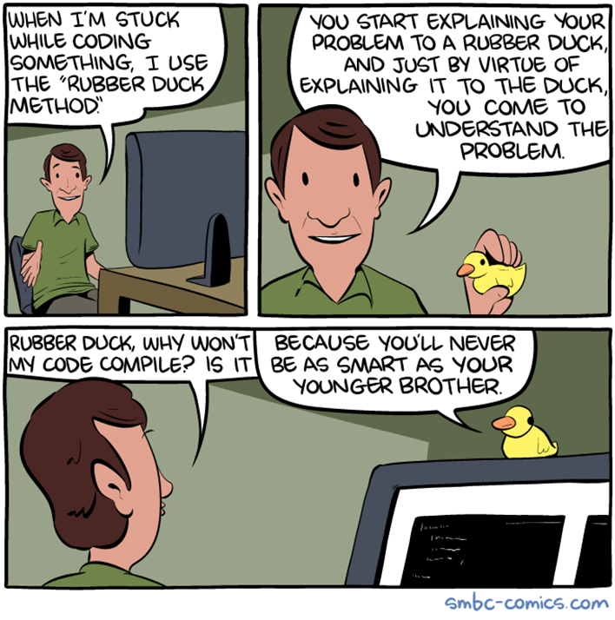

Slide 56
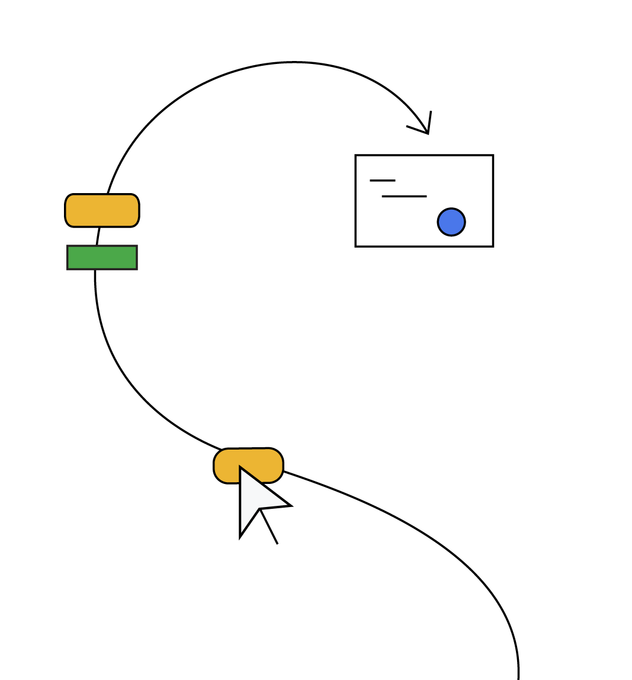
SODOTO
See one — See a procedure and observe how it’s done.
Do one — Do the procedure and practice it.
Teach one — Teach someone else how to do the procedure.

Slide 57


Slide 58
“Publishing your work increases your luck”

Slide 59
How can we increase the odds of finding luck?
Luck is when something unexpected and good happens to you. Unexpected and good. Who doesn’t want to increase the odds of something unexpected and good?
By being a person who works in public. By doing work and being public about it, you build a reputation for yourself.
You build a track record. You build a public body of work that speaks on your behalf better than any resume ever could.

Slide 60
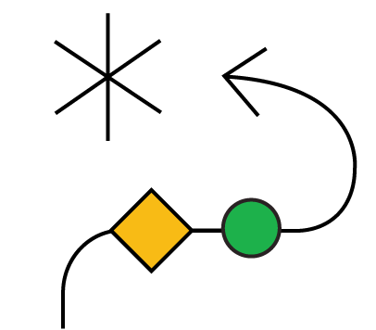
“Luck Surface Area”
— Jason Roberts

Slide 61
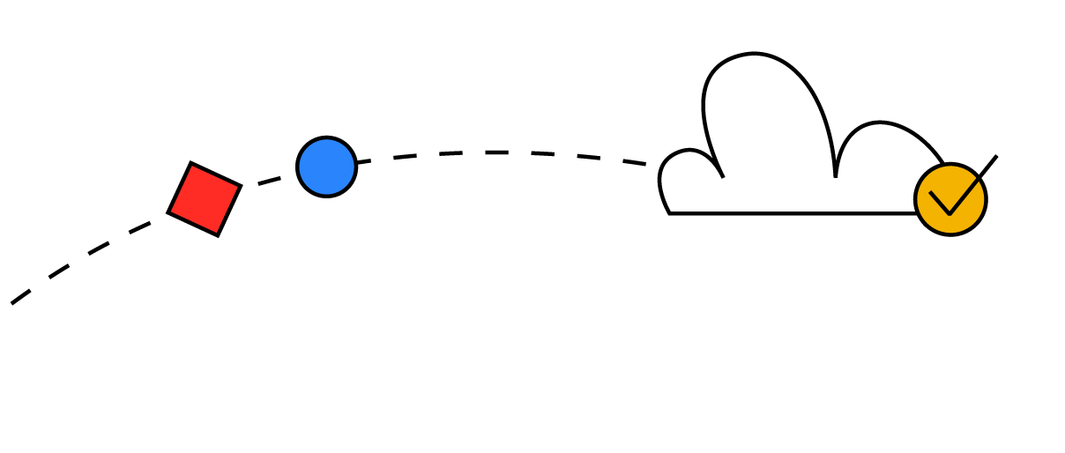
“The amount of serendipity that will occur in your life, your Luck Surface Area, is directly proportional to the degree to which you do something you’re passionate about combined with the total number of people to whom this is effectively communicated.“
Notes:
The word "serendipity" comes from the Persian fairy tale "The Three Princes of Serendip", which was adapted from the poem "Hasht-Bihisht". The term was coined by English author Horace Walpole in 1754 in a letter to his friend Horace Mann. In the letter, Walpole explains an unexpected discovery about a lost painting by Giorgio Vasari, using the fairy tale as an example. The story is about three princes who "always make discoveries, by accidents and sagacity, of things which they were not in quest of"

Slide 62
Start Doing, Amplify with Telling!
The goal is not to become famous, the goal is to increase the chances of luck finding us!

Slide 63
Luck = (Passionate) Doing x (Effective) Telling
The more things you do multiplied by the more people you tell, the larger your Luck Surface Area becomes
The larger your Luck Surface Area, the more likely you are to catch luck as it flows by!
Notes:
Luck = [Doing Things] * [Telling People]

Slide 64
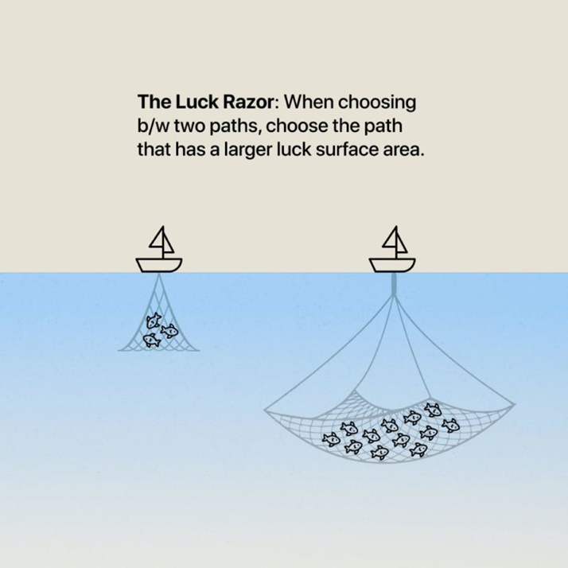

Slide 65
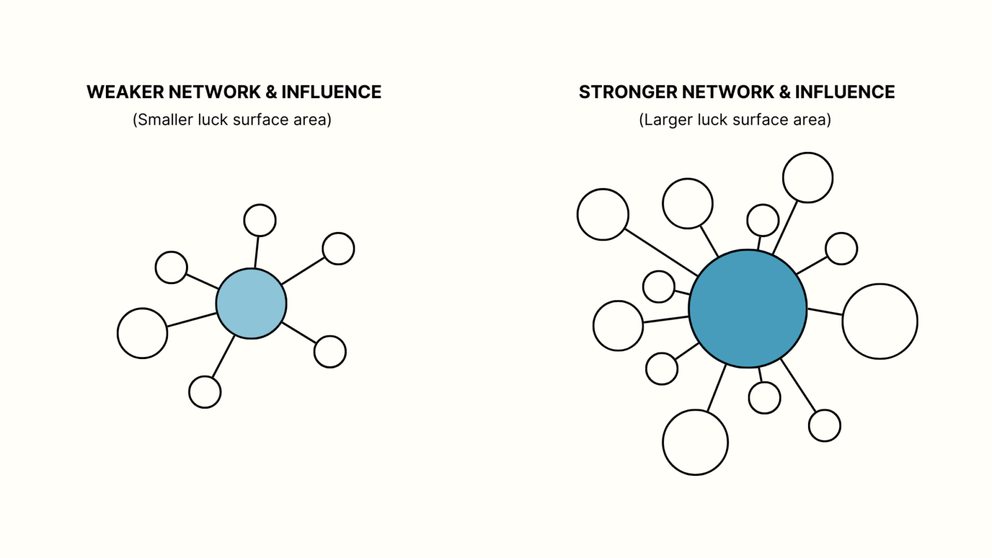
Notes:
Fundamentally, the person with a larger luck surface area is the person who has stronger, deeper, and wider Networks—with significant Influence in those networks.

Slide 66
Which one are you?
You actually are doing things, you’ve just trained yourself to think that anything you do isn’t worth sharing.
You want to be doing things, but you can’t bring yourself to get started.

Slide 67
When people become aware of your expertise, some percentage of them will take action to capture that value, but quite often it will be in a way you would never have predicted.”
The infectious nature of passion, and that taking action and sharing your passion will tend to attract others towards it, again amplified by the number of people who know about it.

Slide 68
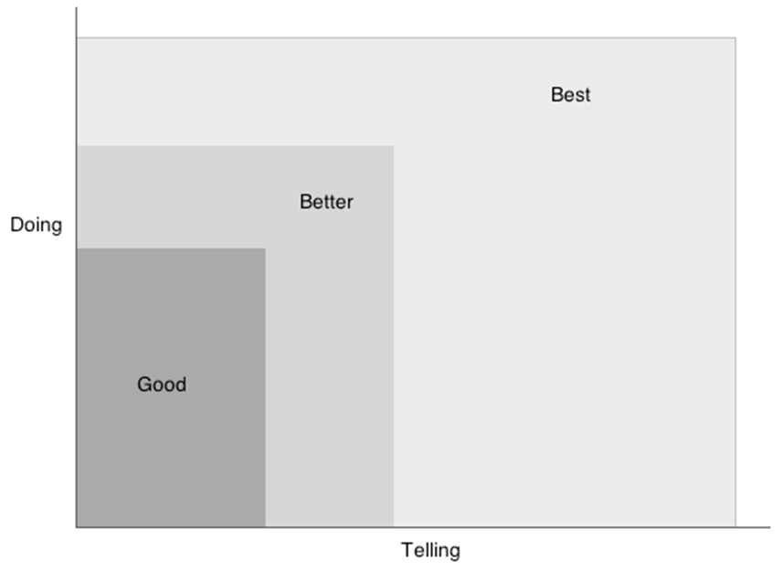
Copyright © 2010 Jason C. Roberts

Slide 69
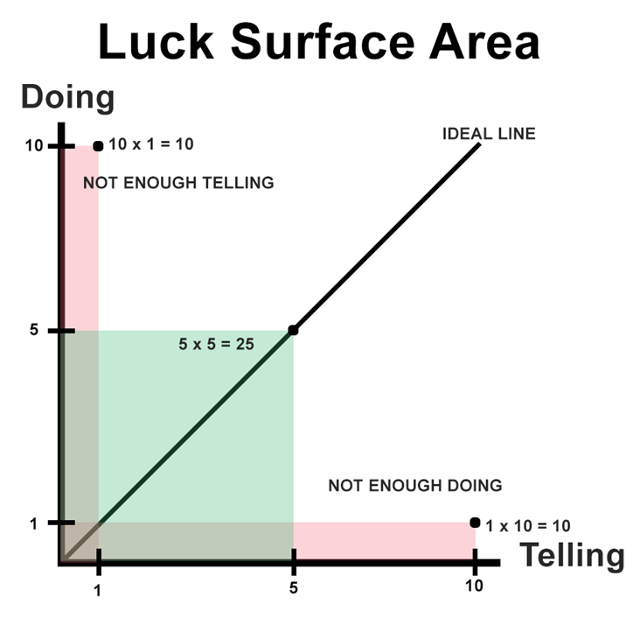

Slide 70
“The law of averages : The relative frequency of an event should correspond to its probability. For example, if the probability of heads in a fair coin toss is 50%, then according to the law of averages, the proportion of heads in a series of tosses should be close to 50%”

Slide 71
Tina Seelig, Stanford professor and the creator of Framestorming, has been studying entrepreneurs and luck for some time
Her reframing of how to view luck aligns well with this model

Slide 72
“Luck is rarely a lightning strike, isolated and dramatic. It’s much more like the wind, blowing constantly. Sometimes it’s calm, and sometimes it blows in gusts. And sometimes it comes from directions that you didn’t even imagine.“
Tina Seelig - Stanford professor and the creator of Framestorming
Notes:
Tina Seelig, Stanford professor and the creator of Framestorming, has been studying entrepreneurs and luck for some time

Slide 73
Whatever you’re excited about, be excited about it publicly.
Blogging, podcasting, commenting in online discussions, and following up with every customer and user, you increase the likelihood of having a serendipitous moment.
It’s a fun concept to consider – but perhaps less of a scientific occurrence than the Law of Averages.

Slide 74
“Engage with people from a place of care and generosity rather than focusing on selling or personal gain. Connecting with the right platforms and communities who might be interested in what you’re doing and are passionate about.”

Slide 75
Share Your Learnings at a Sustainable Pace
Over time, it’s generally more impactful to make small, consistent progress towards an identity-based goal (like being someone who runs regularly) than inconsistently focusing on one huge goal (like running a marathon) - Atomic Habits by James Clear states,
Teaching reveals gaps in our knowledge. When we're aware of those gaps, we become more humble, and we ask more question

Slide 76
Learn the importance of being discoverable by showcasing your work
— Show your work by Austin Kleon

Slide 77
“The person who says he knows what he thinks but cannot express it usually does not know what he thinks.”
— Mortimer Adler

Slide 78

Process, Care, and Craft
Digital gardening : embrace the idea that the process of documenting is more important than the final presentation
Share seeds of thoughts to be cultivated in public
Notes:
A digital garden is an online space at the intersection of a notebook and a blog, where digital gardeners share seeds of thoughts to be cultivated in public.

Slide 79


Slide 80

What’s your superpower?

Slide 81
References
Jason Roberts : https://twitter.com/exojason - Coder, entrepreneur, and podcaster - Luck Surface Area
https://github.com/readme/guides/public-documentation : Monica Powell // Senior Software Engineer, Newsela
https://www.swyx.io/create-luck
https://github.com/readme/guides/publishing-your-work : Aaron Francis // Marketing Engineer, Tuple
https://modelthinkers.com/mental-model/surface-area-of-luck
https://www.skmurphy.com/blog/2019/04/03/increase-your-luck-surface-area-to-get-more-customers/
https://www.linkedin.com/pulse/prot%C3%A9g%C3%A9-effect-why-teaching-someone-else-best-way-learn-simmons/
https://www.growthengineering.co.uk/protege-effect/
https://www.codusoperandi.com/posts/increasing-your-luck-surface-area
https://www.contagiousenthusiasm.com.au/recharge-social-battery/
https://www.brenel.io/blog/luck-surface-area
https://sammatla.com/luck-surface-area/

Slide 82
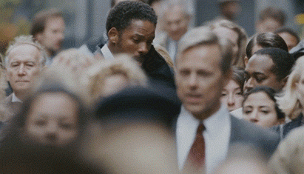
Be healthy both mentally and physically

Slide 83


